Slide 1
COMP SCI 2103/7103 Algorithm Design & Data Structure
Lecture 8– Reducing the cost of recursion: Tail Recursion and Dynamic Programming
SCI 2103/7103 Algorithm Design Data & Data Structure
e 1 - Course Profile and Assessment

Slide 2
Practice with Tail Recursion
Let’s rework some of these problems. As you solve a problem, submit it through Echo 360
Easy problems:
Write a tail recursive function to sum the integers from 1 to n
Write a tail recursive function that implements x^n (ie 2^3 = 2 * 2 * 2)
Write a tail recursive function to calculate greatest common divisor (GCD) of positive integers using Euclid’s algorithm: gcd(a, b) = gcd(b, a mod b) and gcd(a, 0) = a;

Slide 3
More practice
Medium problems
Write a tail recursive function to sum the digits in an integer (ie 362 would return 11 ie 3+6+2 )
Write a tail recursive function to reverse a string
Harder problems
Write tail a recursive function to check whether a string is a palindrome
Write a tail recursive function to compute: f(n) = 1 x 2 + 2 x 3 + 3 x 4 + … + (n-1) x n

Slide 4
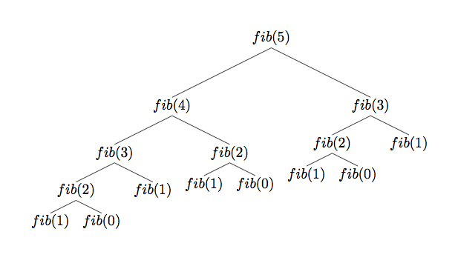
Other performance improvements
int fib(int n) {
if (n == 0 || n == 1) return n;
return fib(n-1) + fib(n-2);
}
This Photo by Unknown Author is licensed under CC BY-SA

Slide 5
Dynamic Programming
Simple concept – save calculated values for reuse
Memoisation: store values as they are calculated
Tabulation: calculate values in advance and then look up when needed
How could we apply Dynamic Programming to our Fibonacci function?

Slide 6
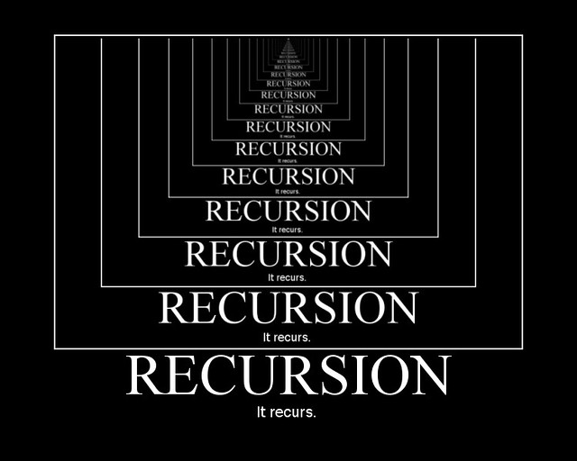
After this lecture….
Look at other solutions to see how peers solved the recursion
Do they meet the criteria
Base case returns accumulator
Recursive call input (subproblem) is closer to base case
Accumulator builds up final value
Helper function sets initial accumulator value and calls tail recursive function
Don’t memorise code for these specific problems, work to identify how the code achieves each of the above criteria so you can work with other problems.
This Photo by Unknown Author is licensed under CC BY-SA

Slide 7
Recursion summing up
Recursion is defining functions in terms of themselves.
It can be easier to understand but does come at a cost.
Tail recursion can help reduce the amount of memory needed for each stack frame
Memoisation or tabulation (Dynamic Programming) can help reduce the number of recursive calls made
Anything you can write recursively can be written iteratively
Consider performance and clarity of the solution when deciding which to use

